Slide 1
Introduction To ML – 2
-Rushikesh dhande

Slide 2
Python Lib for ML
Numpy
Scikit-learn
Pandas
Keras
TensorFlow
Matplotlib
NLTK
Scikit-image
PyBrain
Caffe
StatsModels

Slide 3
Scikit-learn
Scikit-learn was initially developed by David as a Google summer of code project in 2007.
Scikit-learn provides a range of supervised and unsupervised learning algorithms via a consistent interface in Python.
This library, which is largely written in Python, is built upon NumPy, SciPy and Matplotlib.

Slide 4
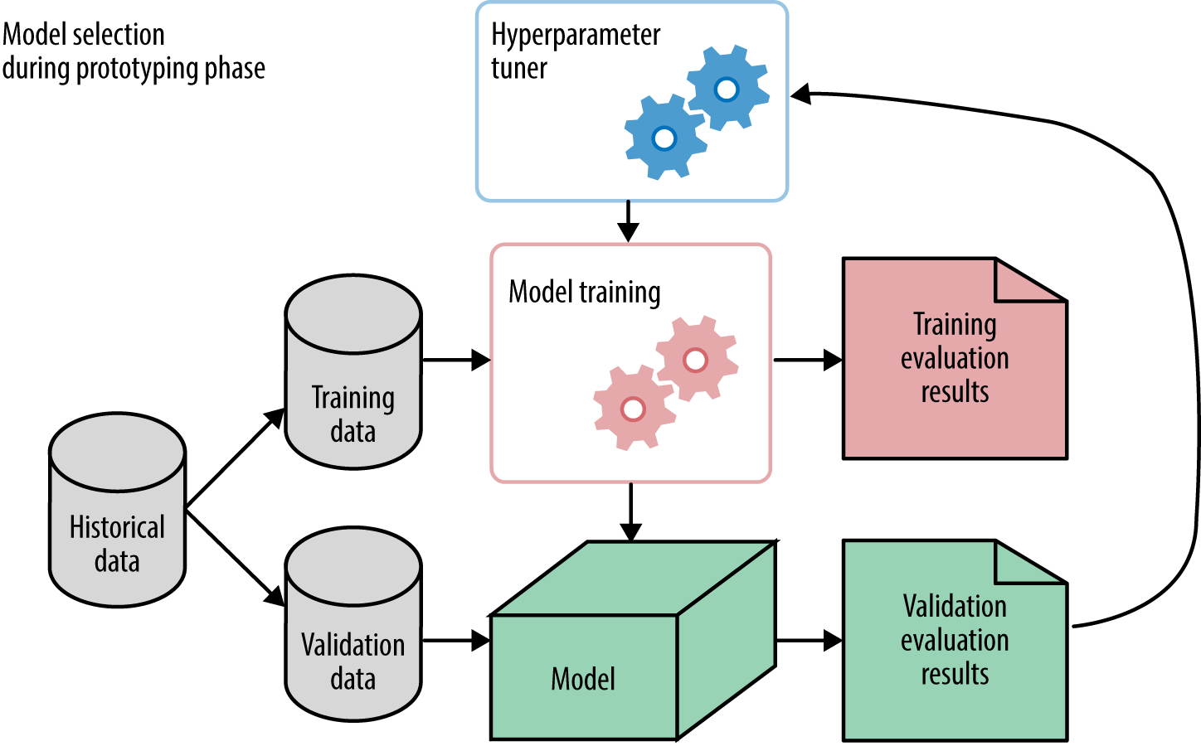
SPLITTING THE DATASET

Slide 5
Splitting the dataset
To check the accuracy of our model, we can split the dataset into two pieces-a training set and a testing set.
train_test_split() function of scikit-learn to split the dataset.
Training data is used for model training.
Testing data is used to check accuracy of the model.

Slide 6
Fit()
In a nutshell: fitting is equal to training. Then, after it is trained, the model can be used to make predictions, usually with a .predict() method call.
Fitting your model to (i.e. using the .fit() method on) the training data is essentially the training part of the modeling process. It finds the coefficients for the equation specified via the algorithm being used.
Syntax: Model.fit(X_train,y_train)

Slide 7
Predict()
Given a trained model, predict the label of a new set of data. This method accepts one argument, the new data X_test.
Syntax: Model.predict(X_test)
It returns the learned label for each object in the array.

Slide 8
Accuracy
Finding accuracy by comparing actual response values(y_test)with predicted response value(y_pred)
from sklearn import metrics
metrics.accuracy_score(y_test, y_pred)
It may be defined as the number of correct predictions made as a ratio of all predictions made.

Slide 9
K-nearest neighbors (KNN)
K-nearest neighbors (KNN) algorithm is a type of supervised ML algorithm which can be used for both classification as well as regression predictive problems.
To evaluate any technique we generally look at 3 important aspects:
1. Ease to interpret output
2. Calculation time
3. Predictive Power

Slide 10


Slide 11
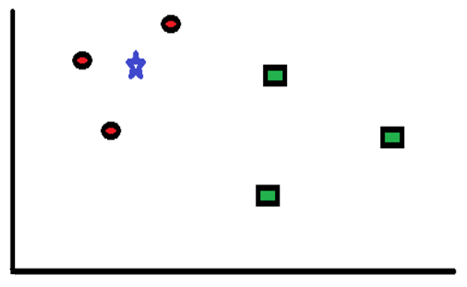
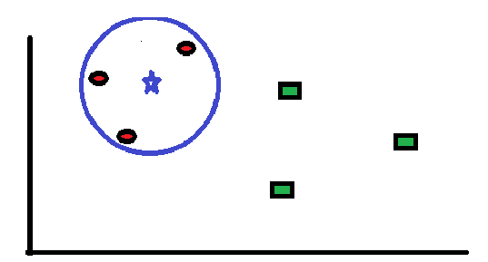
How does the KNN algorithm work?
Let K=3

Slide 12
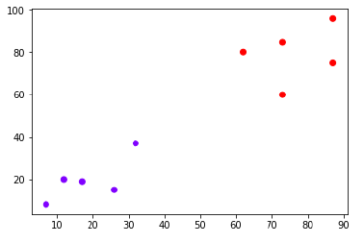
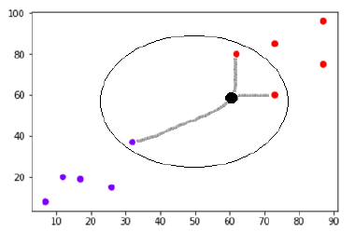
How does the KNN algorithm work?
Let K=3

Slide 13
Pseudo Code of KNN
Load the data
Initialize the value of k
For getting the predicted class, iterate from 1 to total number of training data points
Calculate the distance between test data and each row of training data.
Sort the calculated distances in ascending order based on distance values
Get top k rows from the sorted array
Get the most frequent class of these rows
Return the predicted class

Slide 14
Advantages
The algorithm is simple and easy to implement.
There’s no need to build a model, tune several parameters, or make additional assumptions.
The algorithm is versatile. It can be used for classification, regression, and search (as we will see in the next section).
Disadvantages
The algorithm gets significantly slower as the number of examples and/or predictors/independent variables increase.

Slide 15
Application of KNN
Banking System
KNN can be used in banking system to predict weather an individual is fit for loan approval? Does that individual have the characteristics similar to the defaulters one?
Calculating Credit Ratings
KNN algorithms can be used to find an individual’s credit rating by comparing with the persons having similar traits.
Politics
With the help of KNN algorithms, we can classify a potential voter into various classes like “Will Vote”, “Will not Vote”, “Will Vote to Party ‘Congress’, “Will Vote to Party ‘BJP’.

Slide 16
Project On KNN FOR CLASSIFICATION Iris Dataset
The data set consists 4-Dimention data and 50 samples from each of three species of Iris (Iris setosa, Iris virginica and Iris versicolor)
Given that 'sepal_length', 'sepal_width', 'petal_length', 'petal_width‘ you have to predict the species of flower.

Slide 17
References
https://www.ritchieng.com/machine-learning-k-nearest-neighbors-knn/
https://en.wikipedia.org/wiki/Iris_flower_data_set
https://www.analyticsvidhya.com/blog/2018/03/introduction-k-neighbours-algorithm-clustering/

